Slide 1
2015.06.29(Mon)
Term Project
DC Motor Position Control Using Analog Controller (Lead-Lag Compensator)
Class : | Physical System Modeling and Control
Instructor : | Prof. Park, Kyi Hwan
Members : | 20151049 최윤정 20151160 Abdullah Tahir

Slide 2
Contents
Overview
Plant
Lead Lag Compensator
Current Amp
Videos

Slide 3
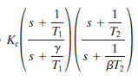
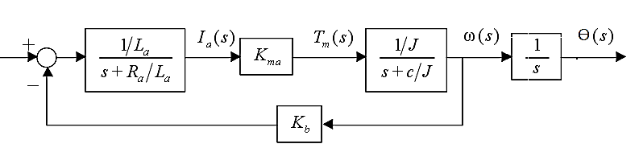
Overview
Block diagram
Block diagram of complete system
V ref
1
+
-
Incremental Encoder Feedback
Subtractor
Lead-Lag Compensator
Current Amplifier with Unity Gain
Armature Controlled Brushed DC Motor

Slide 4
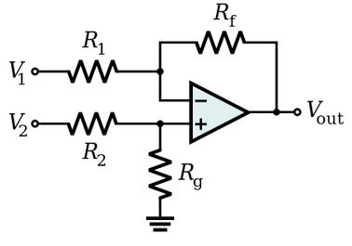
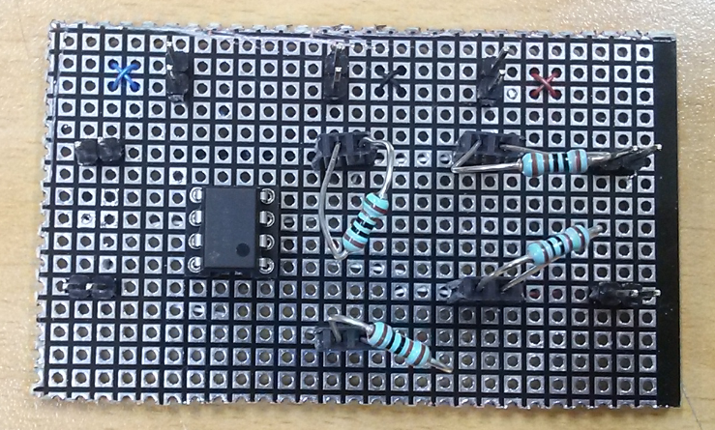
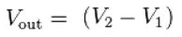
System Modules
Explanation
Block diagram -> Substractor
Substractor
V ref
+
Controller
Current
Amp
Plant
Position
-
Incremental Encoder Feedback

Slide 5
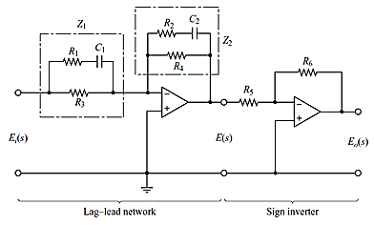
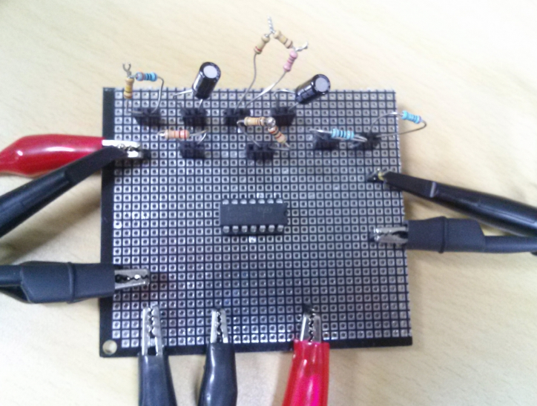
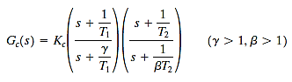
System Modules
Explanation
Block diagram -> Controller
Controller (Lead Lag Compensator)
V ref
+
Controller
Current
Amp
Plant
Position
-
Incremental Encoder Feedback

Slide 6
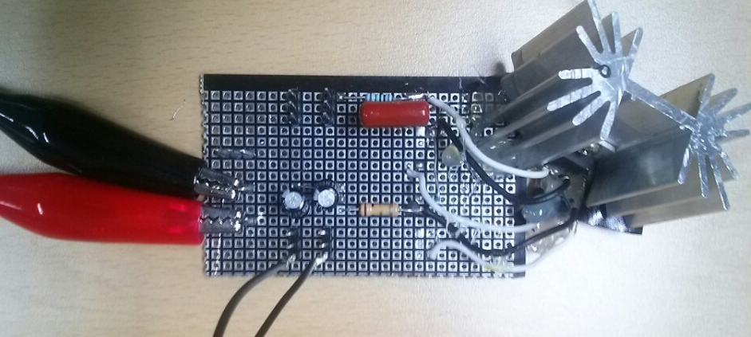
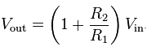
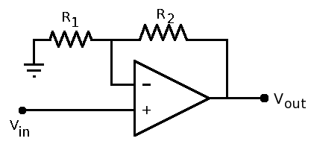
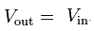
System Modules
Explanation
Block diagram -> Current Amp
Current Amplifier (to drive the Plant)
V ref
+
Controller
Current
Amp
Plant
Position
-
Incremental Encoder Feedback

Slide 7
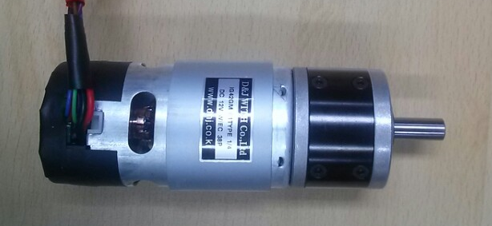
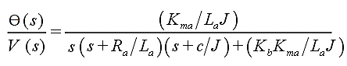
System Modules
Explanation
Block diagram -> Plant
Plant (Armature Controlled DC Motor)
V ref
+
Controller
Current
Amp
Plant
Position
-
Incremental Encoder Feedback
2 Channel
Incremental
Encoder Motor Gear Head

Slide 8
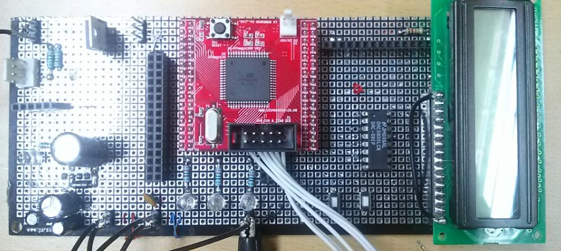
System Modules
Explanation
Block diagram -> Feedback
Feedback
V ref
+
Controller
Current
Amp
Plant
Position
-
Incremental Encoder Feedback

Slide 9
Plant Analysis
(Time Domain and Frequency Domain)

Slide 10
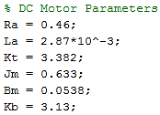
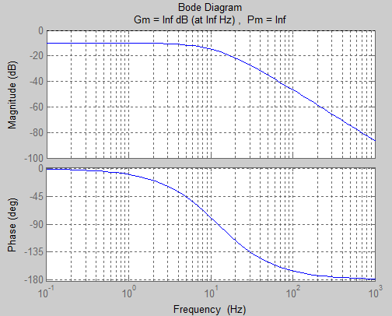
Motor Analysis
Theoretical Analysis
Open Loop
Notes:
Closed

Slide 11
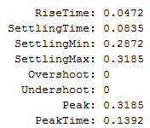
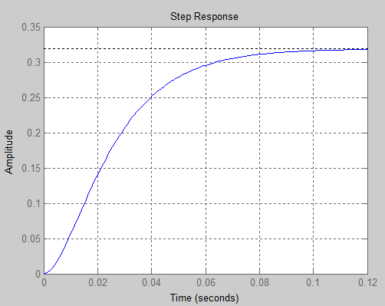
Motor Analysis
Theoretical Analysis
Notes:
Closed

Slide 12
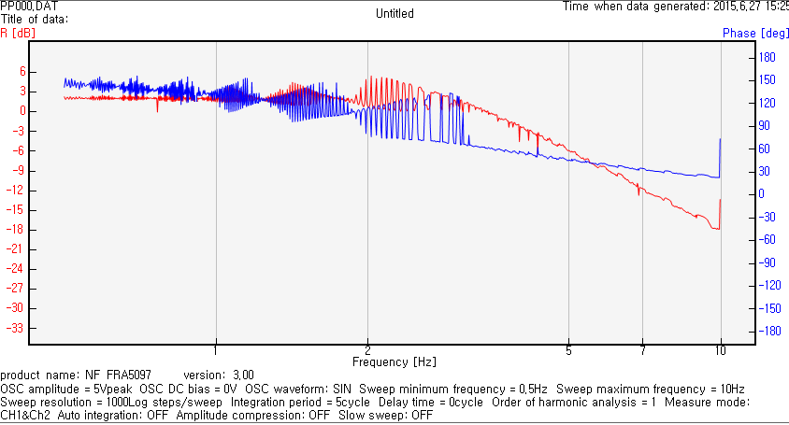
Motor Analysis
Experimental Analysis using FRA (Frequency Response Analyzer)
Notes:
Closed

Slide 13
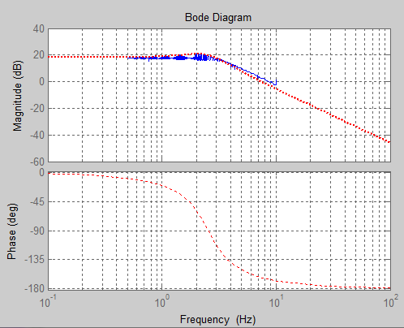
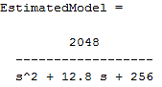
Motor Analysis
FRA (Frequency Response Analyzer) results analysis using Matlab
Notes:
Closed

Slide 14
Lead-Lag Compensator

Slide 15

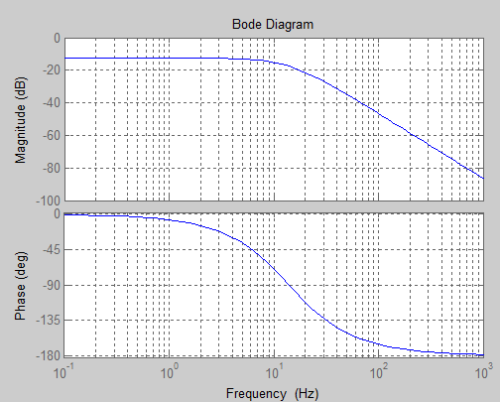
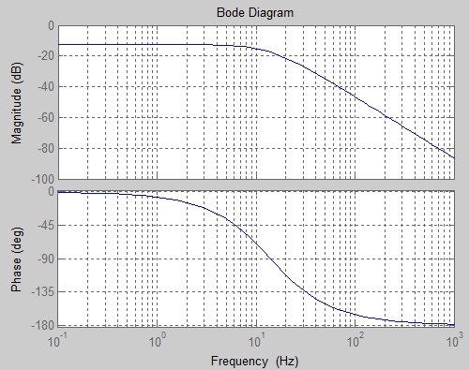
Lead-Lag Compensator
Motor Closed Loop
Compensated System

Slide 16
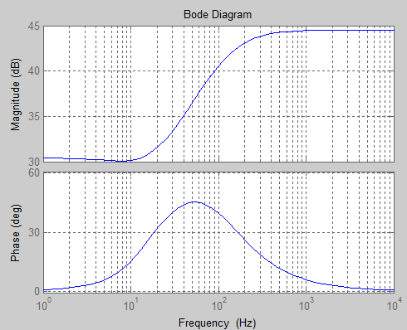
Lead-Lag Compensator

Slide 17
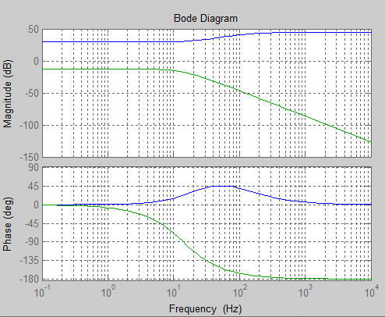
Lead-Lag Compensator
Comparison in Frequency Domain [Bode Plot]

Slide 18
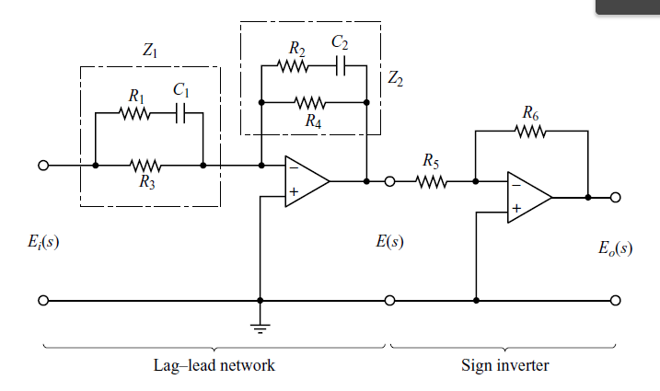
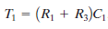
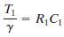
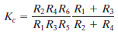
Lead-Lag Compensator
Circuit
Calculate the value of parameters
C1 = C2 =0.1uF
R1 = 12658 Ω
R2 = 116989 Ω
R3 = 84429 Ω
R4 = 59664 Ω
R5 = 1000 Ω
R6 = 46880 Ω

Slide 19
Current Amplifier

Slide 20
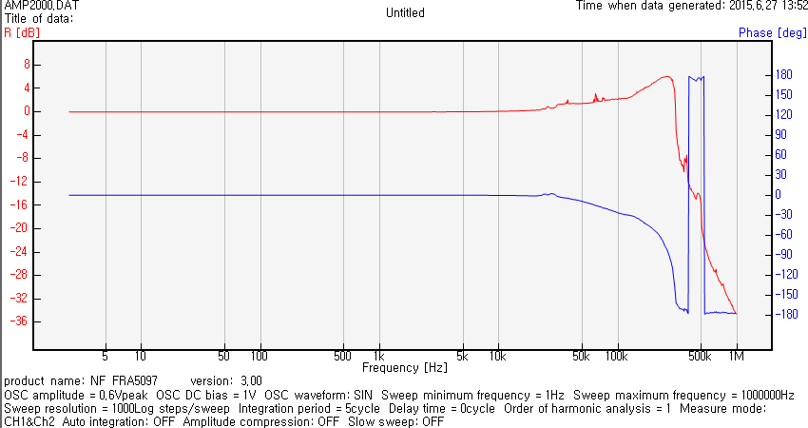
Current Amp

Slide 21
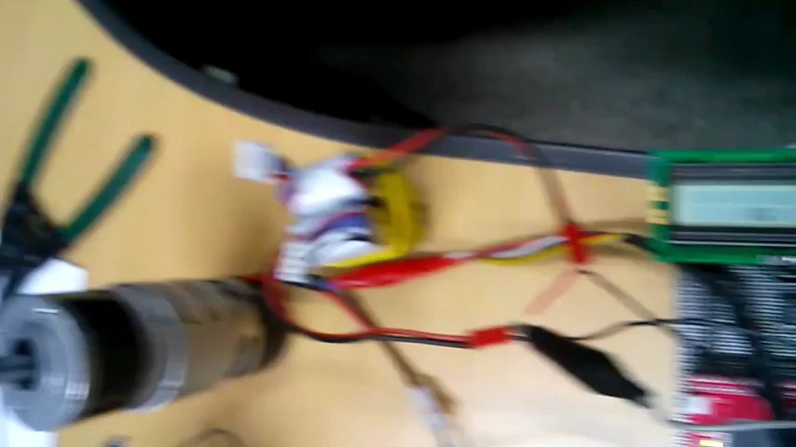
Video

Slide 22

Video

Slide 23
Thank You

